Slide 1
GP & EGO

Slide 2
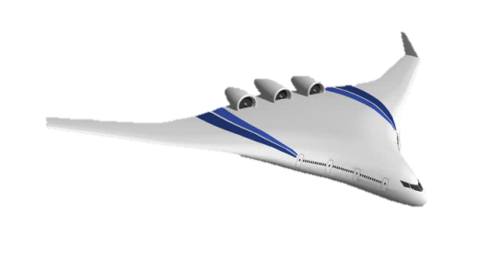
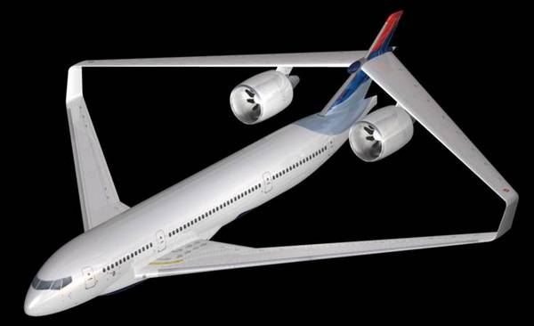
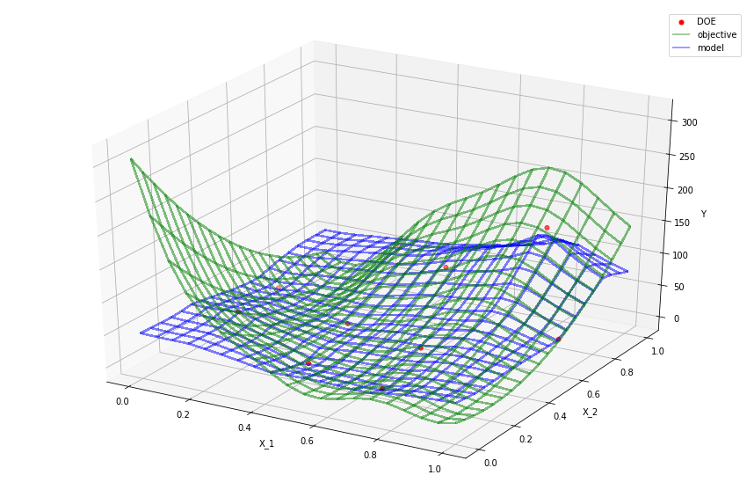
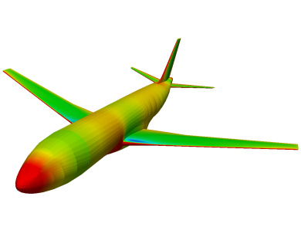
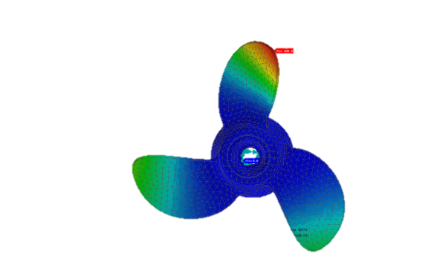
Contexte
Nouvelles configurations
Optimisation Globale
Modèles de substitution
Pas de modèle semi-empirique
Utilisation de codes couteux en temps (dés l’avant projet)

Slide 3
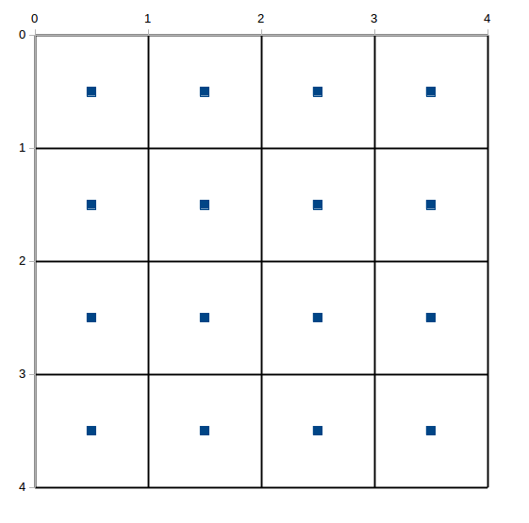
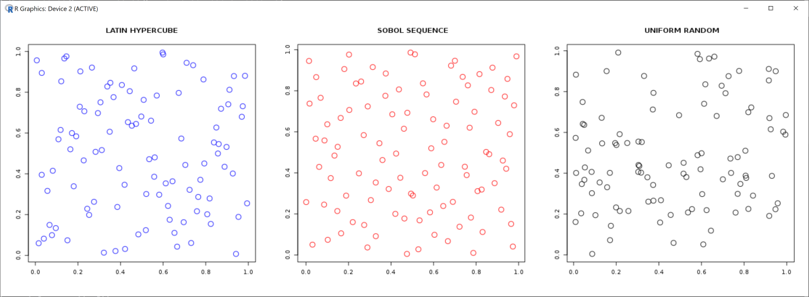
Plan d’expérience
Information sur la fonction $f:ℝ^{d}→ℝ$ dans un espace de design $Ω ⊂ℝ^{d}$
Echantillonnage de points suivant plusieurs méthodes
LHS
Grille régulière
Hasard

Slide 4
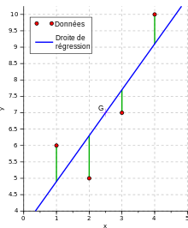
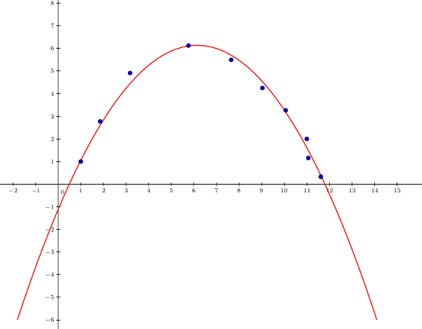
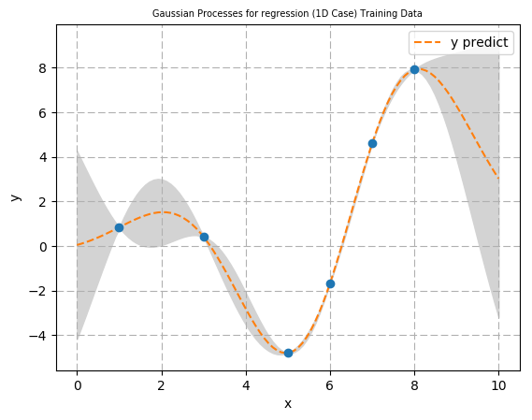
Modèle de substitution
Utilisation des points échantillonnés pour trouver une fonction de prédiction
Régression Linéaire
Régression Quadratique
Processus Gaussien
Donne une prédiction et une erreur pour chaque point du domaine
Donne une prédiction pour chaque point du domaine
et une erreur globale

Slide 5

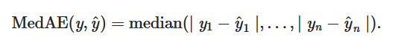
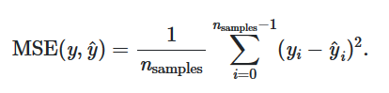
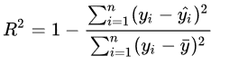
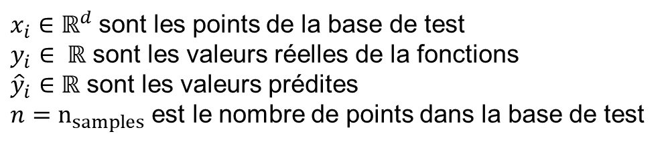
Comment savoir si le modèle est bon
$x_{i}∈ℝ^{d}$ sont les points de la base de test
$y_{i}∈ ℝ$ sont les valeurs réelles de la fonctions
${\hat{y}}_{i}∈ℝ$ sont les valeurs prédites
$n=n_{samples}$ est le nombre de points dans la base de test
Les points de la base de test sont différents des points de la base d’apprentissage
Erreur médiane absolue
Coefficient de détermination
Erreur quadratique moyenne

Slide 6

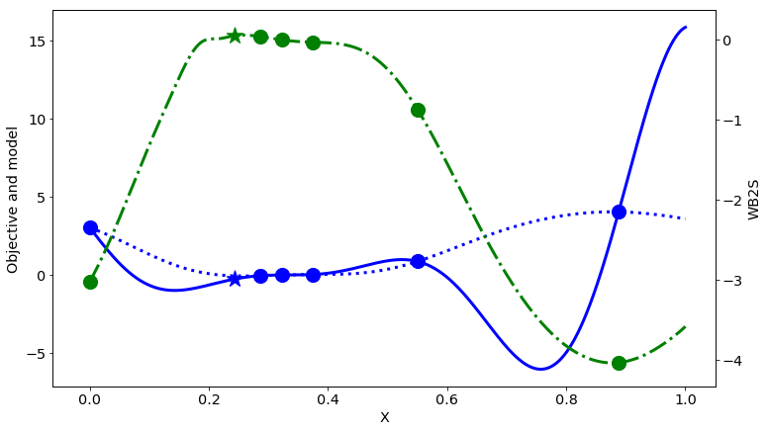
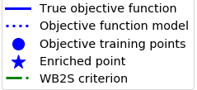
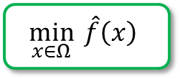
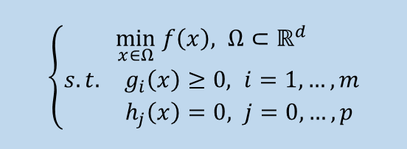

Optimisation par modèle de substitution
Plan d’expérience
Evaluer les points
Entrainement du modèle de substitution
$$\min_{x∈Ω}{f\left(x\right)}$$
$$\min_{x∈Ω}{ \hat{f}\left(x\right)}$$
Problème d’optimisation
$\left\{\begin{aligned}\min_{x∈Ω} f\left(x\right), Ω⊂ℝ^{d} \\ \begin{matrix}s. t. & g_{i}\left(x\right)≥0, i=1,…,m \\ & h_{j}\left(x\right)=0, j=0,…,p \end{matrix}\end{aligned}\right.$

Slide 7
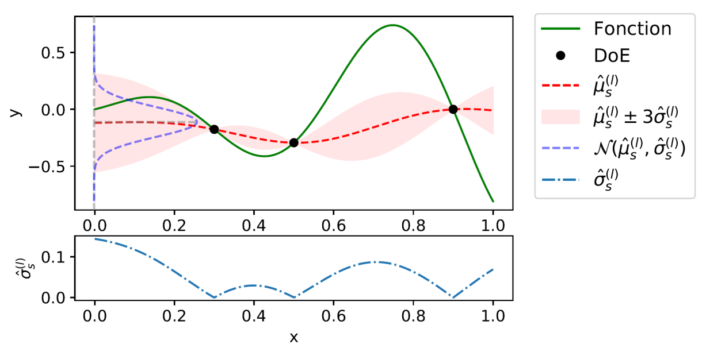
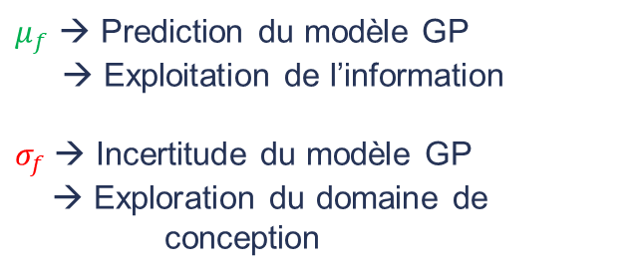
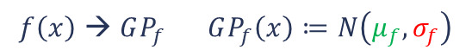
Retour sur les GP
Processus Gaussien (GP) (Rasmussen et al., 2006)
$$\begin{matrix}f\left(x\right) \text{→ }GP_{f} & GP_{f}\left(x\right)≔N\left(μ_{f},σ_{f}\right)\end{matrix}$$
$μ_{f}$ → Prediction du modèle GP
→ Exploitation de l’information
$σ_{f}$→ Incertitude du modèle GP
→ Exploration du domaine de conception
Il faut utiliser ces informations simultanément !!! Exploration vs Exploitation
Rasmussen, C. E. and Williams, C. K. I. Gaussian Processes for Machine Learning. The MIT Press, 2006.

Slide 8

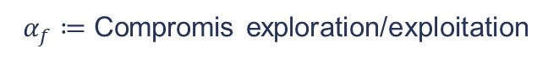
Les fonctions d’acquisition
Fonctions d’acquisition (Mockus et al.)
Explicite
Implicite
$α_{f}≔$ Compromis exploration/exploitation
EI (Mockus et al.)
UCB (Srinivas et al.)
WB2 (Watson and Barnes)
WB2S (Bartoli et al., )
SUR (Picheny et al)
PES (Hernadez-lobato et al.)
MES (Wang et al.)
AL (Picheny et al.)
$\max_{x∈Ω}{α_{f}\left(x\right)} ≔$
Sous-problème d’enrichissement
(2)
Ajouter des points que dans les zones intéressantes !!!!
Bartoli, N., Lefebvre, T., Dubreuil, S., Olivanti, R., Priem, R., Bons, N., Martins, J. R. A. A., Morlier, J. Adaptive modeling strategy for constrained global optimization with application to aerodynamic wing design. Aerospace Science and Technology, 90:85–102, 2019.
Hernández-Lobato, D., Hernandez-Lobato, J., Shah, A., & Adams, R. Predictive entropy search for multi-objective bayesian optimization. In International Conference on Machine Learning, pp. 1492–1501, 2016.
Mockus, J. On Bayesian methods for seeking the extremum. In Optimization Techniques IFIP Technical Conference, pp. 400–404, 1975.
Picheny, V., Gramacy, R. B.,Wild, S., and Le Digabel, S. Bayesian optimization under mixed constraints with a slack-variable Augmented Lagrangian. In Advances in Neural Information Processing Systems 29, pp. 1435–1443, 2016.
Picheny, V. A stepwise uncertainty reduction approach to constrained global optimization. In Artificial Intelligence and Statistics, pp. 787–795, 2014.
Srinivas, N., Krause, A., Kakade, S. M., and Seeger, M. Gaussian process optimization in the bandit setting: No regret and experimental design. In 27th International Conference on Machine Learning (ICML-10), pp. 1015–1022, 2010.
Wang, Z., Jegelka, S. Max-value entropy search for efficient Bayesian optimization. In Proceedings of the 34th International Conference on Machine Learning-Volume 70. pp. 3627–3635, 2017.
Watson, A. G., Barnes, R. J. Infill sampling criteria to locate extremes. Mathematical Geology, 27:589–608, 1995.

Slide 9
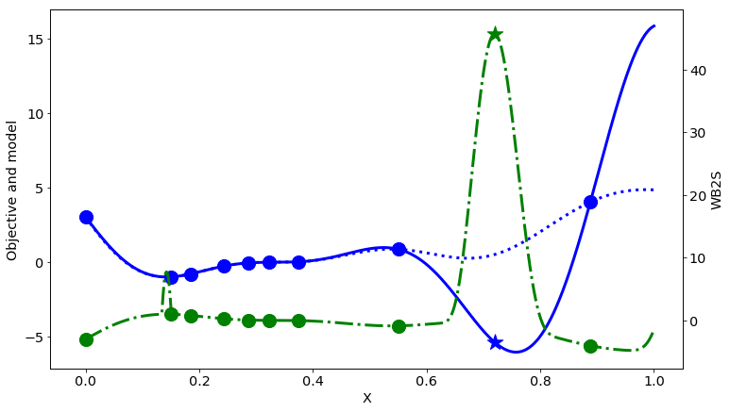
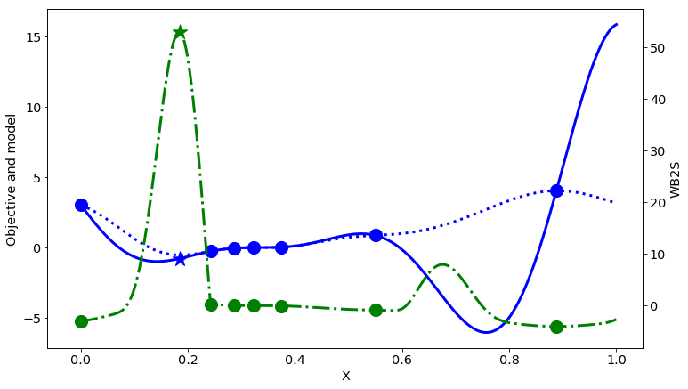
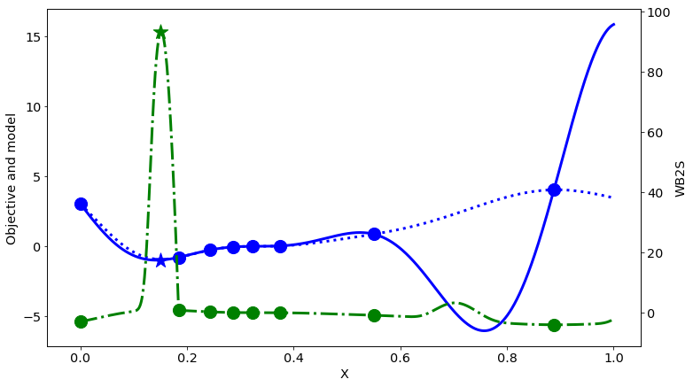
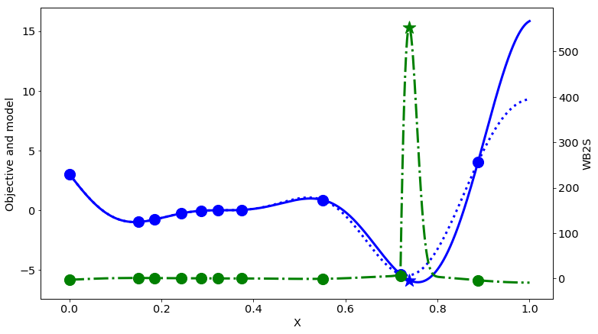

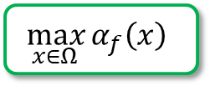
Optimisation Bayésienne
Plan d’expériences
Evaluer les points
Entrainement du modèle Bayésien
$$\min_{x∈Ω}{f\left(x\right)}$$
$$\max_{x∈Ω}{α_{f}\left(x\right)}$$
Fonction à optimiser
Points connus
Processus Gaussien
Fonction d’acquisition
Points à ajouter

Slide 10

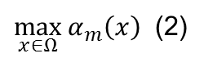
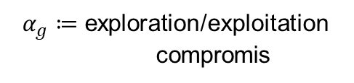
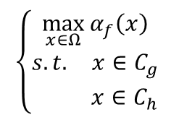
Prendre les contraintes en compte
Problème d’optimisation
Critère de faisabilité (Priem et al, 2020)
$\left\{\begin{aligned}\min_{x∈Ω} f\left(x\right), Ω⊂ℝ^{d} \\ \begin{matrix}s. t. & g_{i}\left(x\right)≥0, i=1,…,m \\ & h_{j}\left(x\right)=0, j=0,…,p \end{matrix}\end{aligned}\right.$
$α_{g}≔$ exploration/exploitation compromis
Différentes versions de UTB sont dispo
Utilisation de l’incertitude et de la prédiction des GP des contraintes
Exemples:
MC
PF
EV
UTB
Méthodes d’enrichissement existantes
2 types de sous problème d’optimisation
+ Adapté à la grande dimension
Information plus dispersé
Sans contrainte
+ Rassemble les infos
Pas adapté à la grande dimension
Contraint
$$\left\{\begin{matrix}\max_{x∈Ω}{α_{f}\left(x\right)} \\ \begin{matrix}s. t. & {x∈C}_{g} \\ & x∈C_{h}\end{matrix}\end{matrix}\right.$$
$\max_{x∈Ω}{α_{m}\left(x\right)}$ (2)
Ex: (Picheny et al., 2016)
Ex: (Sasena et al.,2002 ; Audet et al., 2000 ; Priem et al., 2019)
Priem, R., Bartoli, N., Diouane, Y. & Sgueglia, A. Upper trust bound feasibility criterion for mixed constrained Bayesian optimization with application to aircraft design. Aerospace Science and Technology , 105, 105980 (2020).
Audet, C., Dennis, J., Moore, D., Booker, A., & Frank, P. A surrogate-model-based method for constrained optimization. In 8th Symposium on Multidisciplinary Analysis and Optimization. pp. 4891, 2000.
Sasena, M. J., Papalambros, P., and Goovaerts, P. Exploration of metamodeling sampling criteria for constrained global optimization. Engineering optimization, 34:263–278, 2002.
Bartoli, N., Lefebvre, T., Dubreuil, S., Olivanti, R., Priem, R., Bons, N., Martins, J. R. A. A., Morlier, J. Adaptive modeling strategy for constrained global optimization with application to aerodynamic wing design. Aerospace Science and Technology, 90:85–102, 2019.

Slide 11
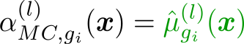
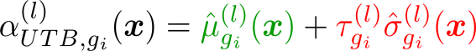
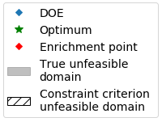
Prendre les contraintes en compte
Branin Modifié (MB) (Parr et al., 2010)
2 variables
1 contraintes ineq
MC (Sasena et al., 2002)
UTB (Priem et al., 2020)
Parr, J., Holden, C. M. E., Forrester, A. I. J., and Keane, A. J. Review of efficient surrogate infill sampling criteria with constraint handling. In 2nd International Conference on Engineering Optimization, pp. 1–10, 2010.
Priem, R., Bartoli, N., Diouane, Y. & Sgueglia, A. Upper trust bound feasibility criterion for mixed constrained Bayesian optimization with application to aircraft design. Aerospace Science and Technology , 105, 105980 (2020).
Sasena, M. J., Papalambros, P., and Goovaerts, P. Exploration of metamodeling sampling criteria for constrained global optimization. Engineering optimization, 34:263–278, 2002.

Slide 12
Gérer la grande dimension
ID : Trouver les directions les plus importante
1 : utiliser la réduction de dimension dans le noyau de covariance
KPLS : Bouhlel, M. A., Bartoli, N., Otsmane, A. & Morlier, J. An improved approach for estimating the hyperparameters of
the kriging model for high-dimensional problems through the partial least squares method. Mathematical Problems
in Engineering 2016, (2016).
MGP : Garnett, R., Osborne, M. & Hennig, P. Active Learning of Linear Embeddings for Gaussian Processes. in Proceedings
of the 30th Conference on Uncertainty in Artificial Intelligence (UAI 2014) 10 (2014).
BOCK : Oh, C., Gavves, E. & Welling, M. BOCK : Bayesian Optimization with Cylindrical Kernels. in Proceedings of the 35th
international Conference on Machine Learning 3868–3877 (2018).
Utilisation de ces GP dans le processus BO
Ok en dimension réduite < 100
2 : utiliser la réduction de dimension avant la construction du GP
Ok en dimension grande > 100

Slide 13
Gérer la grande dimension
Surrogate Model Toolbox: SMT
https://github.com/SMTorg/SMT
Bouhlel, M. A. et al. A Python surrogate modeling framework with derivatives. Advances in Engineering Software 135, 102662 (2019).

Slide 14
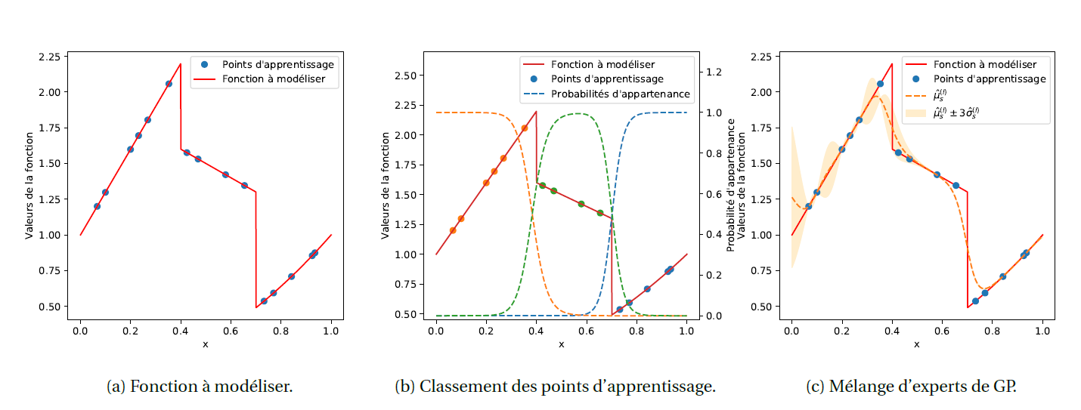
BO exotique dans SMT (Mélange d’expert)
Bettebghor, D., Bartoli, N., Grihon, S., Morlier, J., & Samuelides, M. (2011). Surrogate modeling approximation using a mixture of experts based on EM joint estimation. Structural and multidisciplinary optimization, 43(2), 243-259.

Slide 15
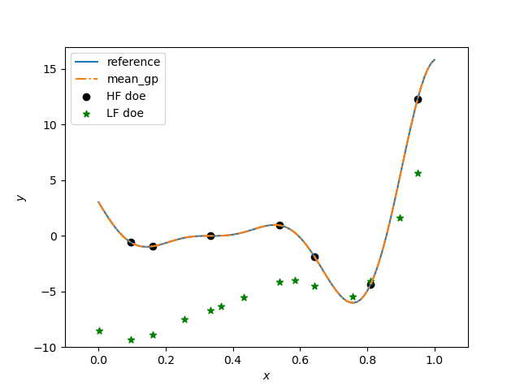
BO exotique dans SMT (Multifidélité)
Fid 1
Fid 2
Meliani, M., Bartoli, N., Lefebvre, T., Bouhlel, M. A., Martins, J., & Morlier, J. (2019). Multi-fidelity efficient global optimization: Methodology and application to airfoil shape design. In AIAA Aviation 2019 Forum (p. 3236).

Slide 16
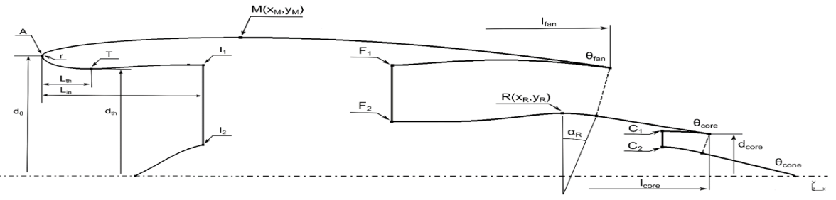


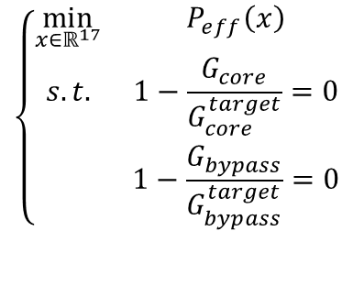
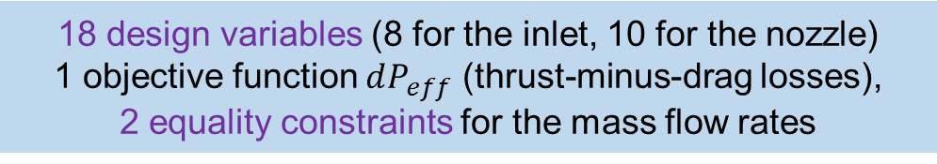
Exemple 1 (Nacelle du TSAGI)
Problème d’’optimisation
$$\left\{\begin{matrix}\min_{x∈ℝ^{17}} & P_{eff}\left(x\right) \\ s.t. & 1−\frac{G_{core}}{G_{core}^{target}}=0 \\ & 1−\frac{G_{bypass}}{G_{bypass}^{target}}=0\end{matrix}\right.$$
18 design variables (8 for the inlet, 10 for the nozzle)
1 objective function $dP_{eff}$ (thrust-minus-drag losses),
2 equality constraints for the mass flow rates
EU H2020 project, 2015-2018
CFD computations (TsAGI in-house code EWT)
High-bypass-ratio engine (BPR = 13)
Regime: M = 0.78, H = 11 km (Cruise)
RANS, Spalart-Allmaras turb. Model
Axisymmetric grid, N = 236544 cells
1 run = 30 min on 48 cores

Slide 17
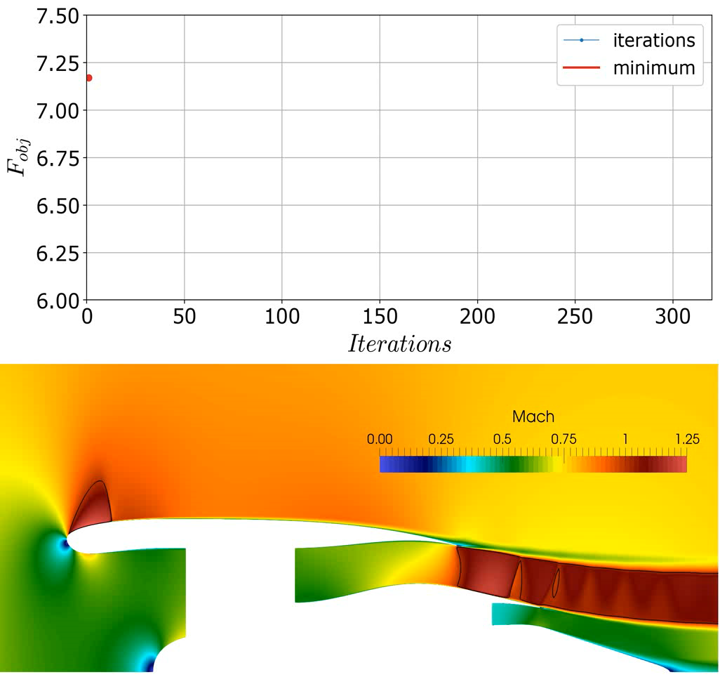
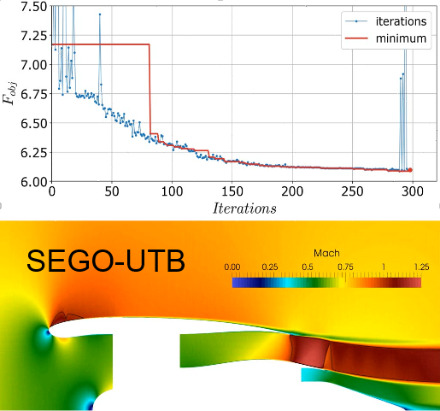

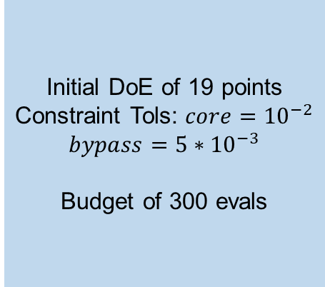
Example 1
Optimizer settings
Value
Best valid value
Initial DoE of 19 points
Constraint Tols: $core={10}^{−2}$
$$bypass=5∗{10}^{−3}$$
Budget of 300 evals
Priem, R., Bartoli, N. & Diouane, Y. On the Use of Upper Trust Bounds in Constrained Bayesian Optimization Infill Criteria. in Proceedings of the AIAA AVIATION 2019 FORUM 2986 (2019).

Slide 18
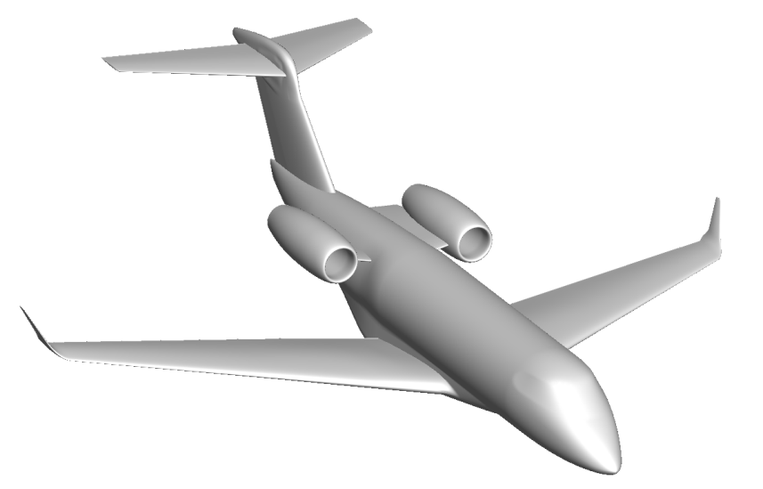
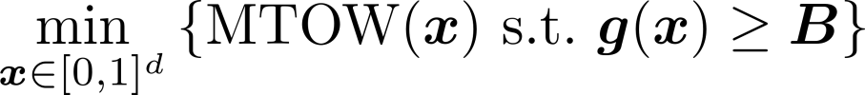
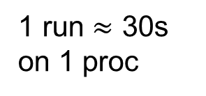
Exemple 2 (Avion de recherche de Bombardier Aviation)
Idea
Information
Research configuration to work with universities without confidentiality constraints
Based on the Challenger 300
12 Variables
7 Constraints
1 run $≈$ 30s on 1 proc
BRAC Baseline
Reist, T. A. et al. Cross Validation of Aerodynamic Shape Optimization Methodologies for Aircraft Wing-Body Optimization. AIAA Journal 1–15 (2020).

Slide 19
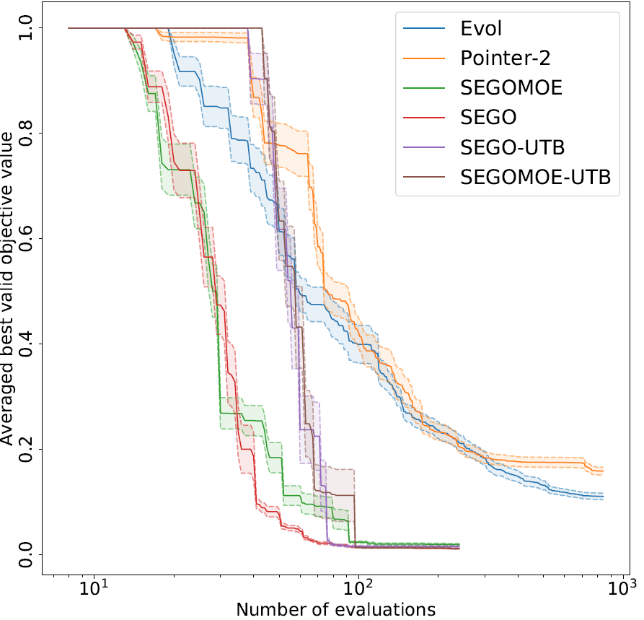
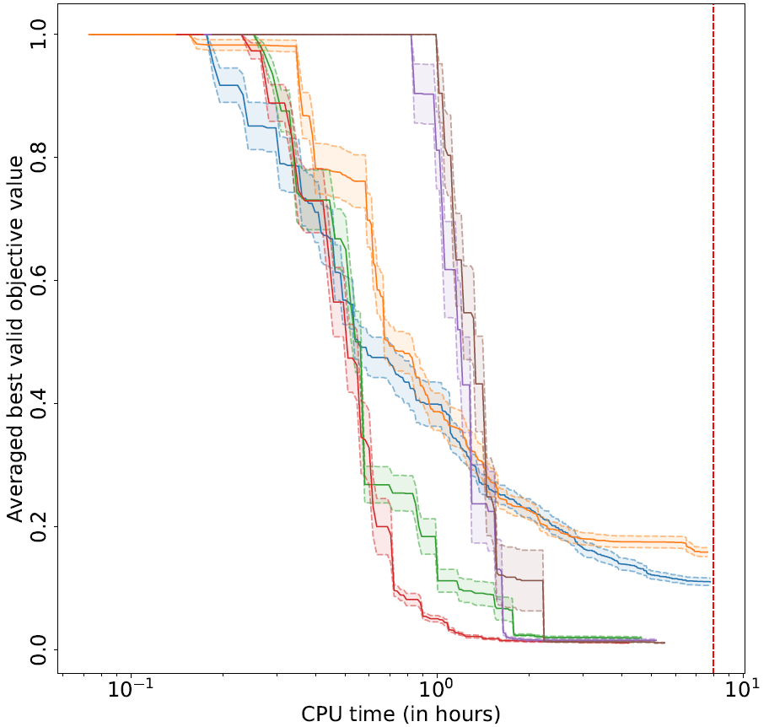
Exemple 2
Maximum time allowed
Conclusion
SEGO is converging faster than other solvers (2h vs 8h)
SEGO-like solvers are converging faster (in time and evaluation) compared to Evol and Pointer-2
SEGO-UTB likely needs more time to converge → More explorative
Priem, R., Bartoli, N., Diouane, Y. & Sgueglia, A. Upper trust bound feasibility criterion for mixed constrained Bayesian optimization with application to aircraft design. Aerospace Science and Technology , 105, 105980 (2020).

Slide 20
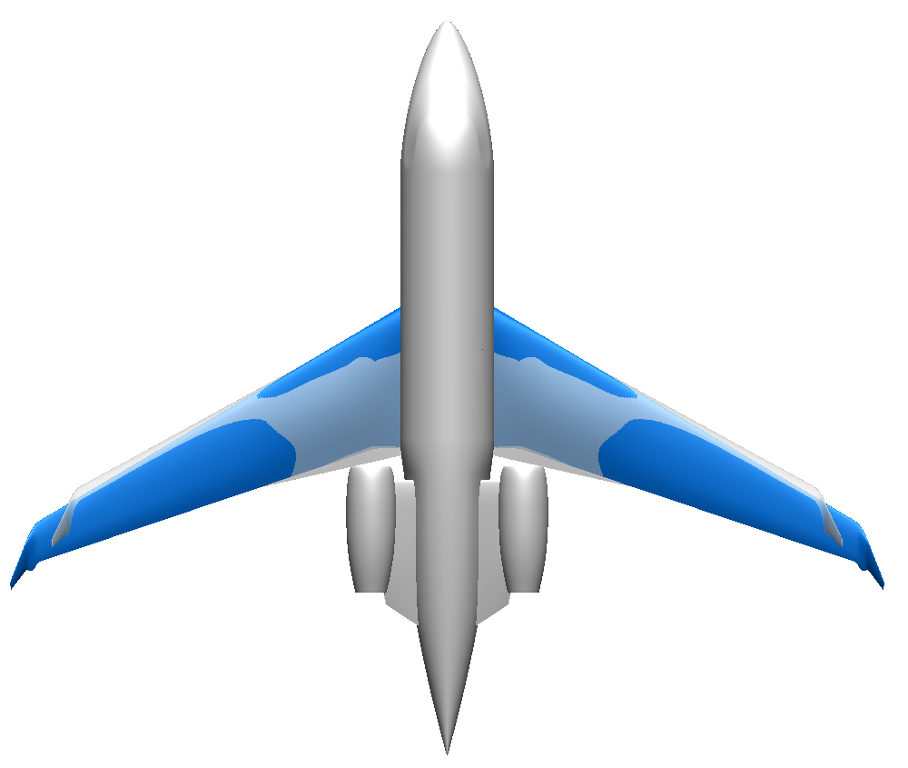
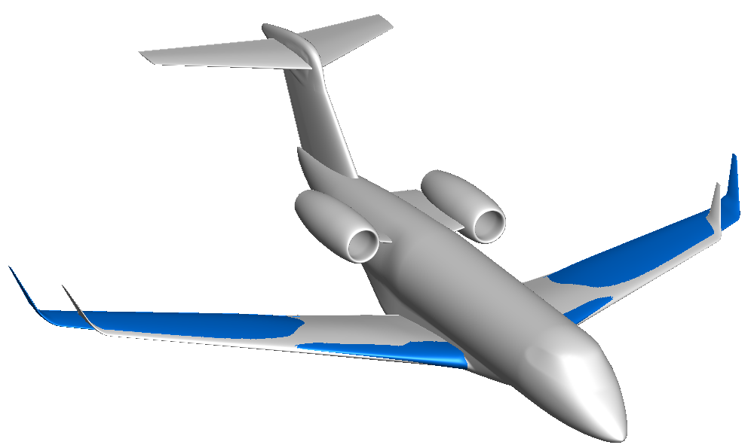
Exemple 2
Optimized by CMDO
Optimal Configuration
Baseline Configuration
Priem, R., Bartoli, N., Diouane, Y. & Sgueglia, A. Upper trust bound feasibility criterion for mixed constrained Bayesian optimization with application to aircraft design. Aerospace Science and Technology , 105, 105980 (2020).

Slide 21
MOPTA (Cas test automobile)
Problem formulation:
1 objective function to be minimized - mass
124 variables normalized to [0,1]
68 inequality constraints of form g_{i} (x) ≤ 0
Constraints well normalized: 0.05 means 5% over requirement, etc.
Test problem comes with the initial feasible point with objective ~251.07
A good performance would be comparable or better than derivative-free optimization algorithm - Powell’s COBYLA:
Number of evaluations = ~ 15 x Number of variables
Fully feasible solution (no constraint violations)
Objective function value ≤ 228 (at least 80% of potential reduction)
"Anything better is exciting" - states Don Jones, the author of this benchmark.

Slide 22
MOPTA

Slide 23
BUT du BE
Partie 1 : Optimisation des hyper-paramètres du GP
Partie 2 : Mise en place de l’algorithme EGO
Partie 3 (Optionnelle) : Mise en place de SEGO

